Slide 1
Contribute to Learn:
Building DF/IR Expertise Through Open Source
Christopher Eng / ogmini
Notes:
Good afternoon everyone this is the first time I’ve attended BSIDES NYC and I am grateful to the organizers and volunteers for helping to make this conference happen. My presentation is on building DF/IR expertise through open source contributions.

Slide 2
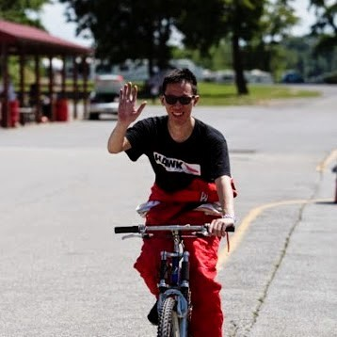
$me = Get-Item .\christopher.eng
$me.Name - Christopher Eng
$me.CreationTime - redacted
15+ years of IT experience
Independent Digital Forensic Researcher
Work and thoughts are solely my own and not that of my employer
Notes:
My name is Christopher Eng. I also go by OGMINI online. I have over 15 years of IT experience ranging from Help Desk to System Administration to Software Development and I am now the CIO over at Guttman Community College. I recently graduated from Champlain College with a Masters in Digital Forensic Science in 2023 because I wanted a new challenge that would combine my years of varied experience and knowledge. I now find myself doing independent digital forensic research as I continue to explore my interests and figure out where I might pivot. This journey has led me to this presentation and I hope to provide some insights and guidance on how a simple pull request can lead to levelling up your skills and growing your network.
I want to quickly thank my family for giving me the time to do all of this. I’m currently missing a Trunk-Or-Treat event with them.
One other quick note is that this presentation, work, and thoughts are solely my own and not that of my employer.

Slide 3

Why this talk?
Where do I go from here?
How can I really learn DF/IR?
Notes:
So, why this talk? After graduating I had a few questions arise:
Where do I go from here?
I wanted more. I was greedy for knowledge. I wanted something that could combine my background in software development to more directly contribute to the DF/IR field.
How can I really learn DF/IR?
There are many great ways to learn DF/IR such as books, courses, certifications, and CTFs. My coursework at Champlain College spanned many topics from legal considerations and principles, mobile device analysis, malware, etc. It served to bust the doors open of what is out there and I was like a kid in a candy shop. I want this, this, and this. I’ve started to participate in some of the more Digital Forensic centered CTFs such as the BelkaCTF and MagnetCTF. These are great in providing pretty realistic scenarios with new evidence sets. Problem, CTFs don’t always line up with my schedule and happen yearly at best.
How can I network?
Networking is so important in any job. A popular option to get started is blogging or making regular posts about DF/IR topics. I’m currently in the midst of the Zeltser Challenge issued by a friend David Cowen. The challenge is to post daily for at least a year. There are no hard and fast rules on what you can post about. I’ve done pretty good so far minus vacations and sicknesses.
How can I contribute to the DF/IR field?
Open Source!

Slide 4
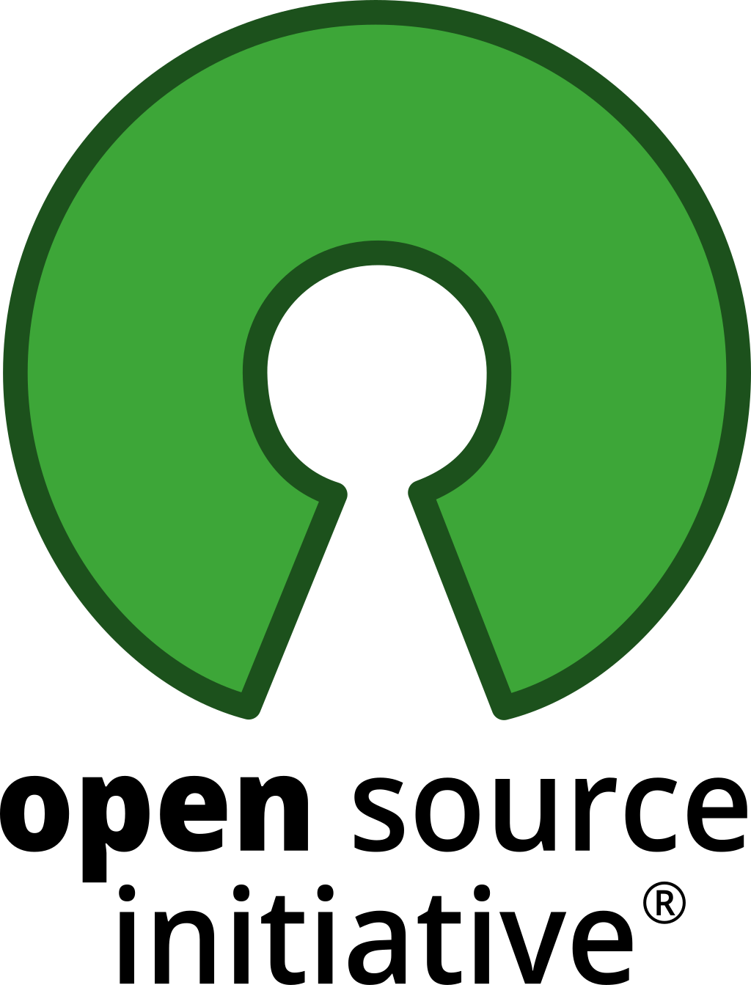
Why Open Source Matters
Real world tools, real world problems
Transparent
Agile
Customizable
Collaboration
Peer Review
Modifiable
Notes:
Many popular forensic tools are open source. These include examples such as
KAPE and the various Zimmerman Tools from Eric Zimmerman (Not all of these are Open Source but they are setup in a way to be able to make contributions)
The various LEAPPS from Alexis Brignoni (ALEAPP, iLEAPP)
Velociraptor from Michael Cohen / Rapid7
Wireshark for network traffic analysis, Ghidra for reverse engineering, imHex Hex Editor and the list goes on and on. These are all real world tools being used to solve real world problems.
How many of you have used or heard of these tools? How many of you have contributed to them?
Under 60 contributes to ALEAPP
Transparent - you can see how and why things work. This is great for learning and validation via peer review. Why did the tool say the file was created on January 1, 1601? Where did the tool find this digital artifact that says the user opened up Remote Desktop. You could dive into the code and find out.
Customizable and Agile - they can be updated or modified to handle one off or quickly evolving situations. You don’t have to wait for the vendor to find the development time. You with enough knowledge could make the code change to add that support or feature.
They offer a great platform to collaborate with others around the world. Not just in your company, your country, your social circle.
In my opinion, the greatest thing is that you can learn about DF/IR artifacts just by understanding how these tools work. Nothing is hidden and you can see where artifacts exist.

Slide 5
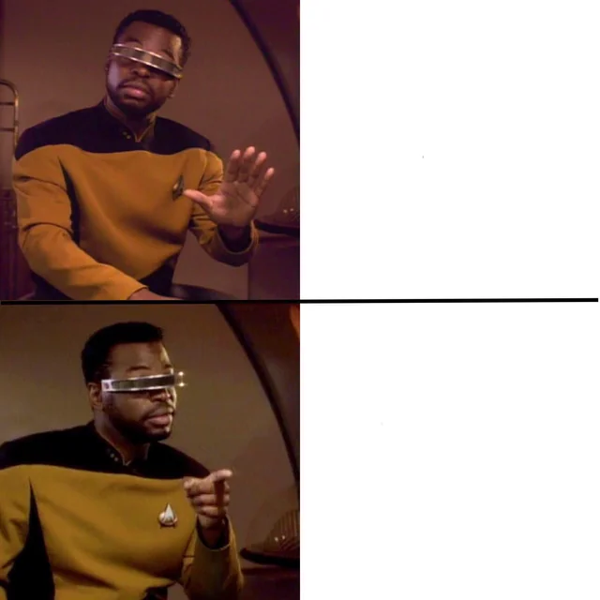
Ways to Contribute
Just using a Forensic Tool
Documentation / Discussion
Testing / Validation
Pull Requests
Contributing to a Forensic Tool
Notes:
So how do I get involved?! You can contribute to projects in three main ways
Documentation/Discussion - Documenting how to use the tool. The options and features that it has. Example use cases. Discussing with other contributors about future features.
Testing/Validation - Document results from running tools on known or new datasets. Make sure that it works how you expect it to work. Collaborating with other contributors to test and validate.
Pull Requests Coding/Issues - Making direct contributions to the codebase. Fixing open issues/requests, adding new functionality. This requires testing and researching that needs to be done and documented.
All three of these are related to each other.
As Geordi is pointing out. Anyone can use a forensic tool. Few actually contribute to a forensic tool and give back to the DF/IR community.

Slide 6




My A-Ha! Moments
Collaboration
KAPE Targets/Modules
Velociraptor
ALEAPP
CTF Artifacts
Notepad State Library
Notes:
Going back to my current journey. I started with my own project on Windows Notepad and published the tool and research on GitHub. This led to some collaboration with a few others across the world who were also doing similar research. It was at this point I realized that contributing to other projects would be a great way to answer those earlier questions I had after graduating. Since that time, I’ve contributed to a few projects that I had used or wanted to learn how to use such as:
KAPEFiles which are the targets and modules that are used by KAPE
Velociraptor via the Artifact Exchange and Issues to make a feature suggestion
ALEAPP artifact plugin based off of digital artifacts for IMAP emails from a recent CTF
I’ve also had the pleasure of collaborating with DF/IR professionals around the world and engaging in discussions with them. I wouldn’t have been able to make those connections otherwise.
Contributing to projects require you to engage with the tools at a much deeper level than just using the tool. You have to understand the digital artifacts and the nuances of how the tool operates in order to make those contributions.

Slide 7
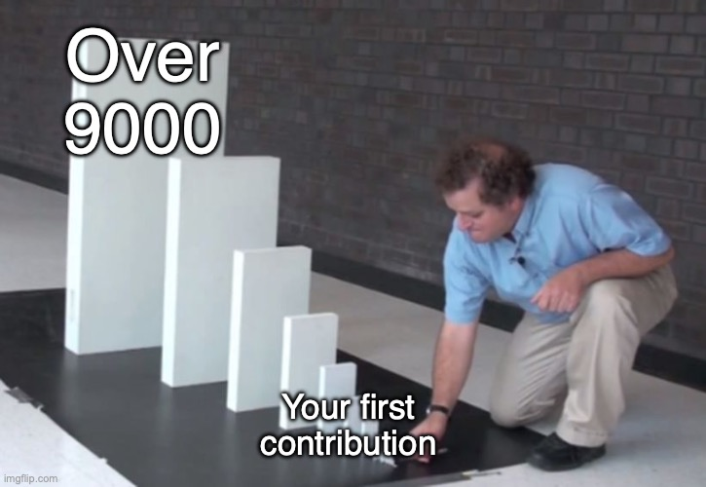
Getting Started/Tips
Don’t need to be a developer
Update/write documentation
Participate in discussions
Help test/validate changes
Notes:
Some quick tips for getting started. You don’t need to be a developer or really have any coding experience to get started. I do believe that it will be a useful skill in any DF/IR career and this is one way to get coding experience. Learning Python is a good language to start with that will prove very useful.
Often the documentation can be out of date or weak for projects and have room for improvement. This is a crucial part of any forensic tool and a great place to start for anyone. In order to write good documentation, you need to know how to use the tool! I would heavily encourage the submission of documentation to the project itself and not just writing it on your blog. Documentation can also go beyond just using the tool. You can document existing plugins by linking to existing writeups or research on the artifacts. If they don’t exist, maybe you could do the research and do the writeup. Do that validation.
Participate in discussions, read issues and pull requests. You might know something that someone else does not. Conversely, you might learn something new. Also, if you see a lot of common or re-occuring questions you could write an FAQ.
One last thing you could do is help validate and test tools on various datasets. See if you can replicate someone’s results using a tool. Let us say someone else wrote a plugin, you could help them test with your own generated dataset.
As you can see there are options other than coding that allow you to contribute.

Slide 8
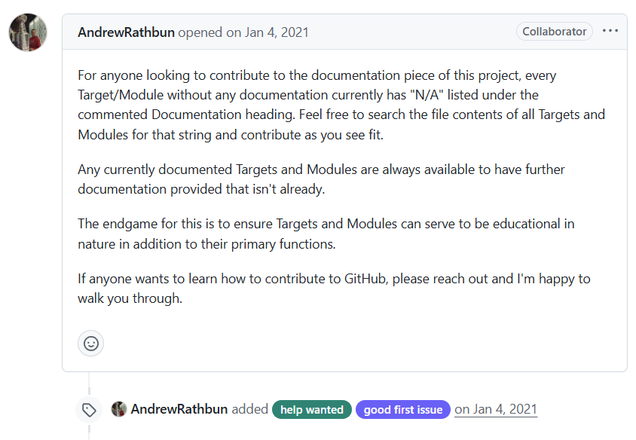
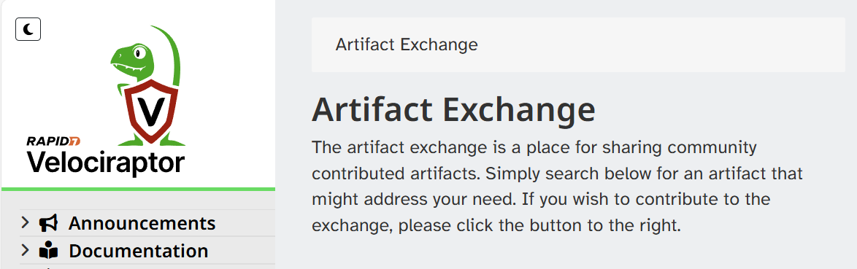

Call to Action
https://github.com/EricZimmerman/KapeFiles
https://docs.velociraptor.app/exchange/
Notes:
I leave you with a call to action. Get in there, pick an open source project that you use a lot, want to learn, or find interesting. Do the work and hit that “New Pull Request” button. That is all it takes to start contributing and learning.
A good one to start with is Andrew Rathbun has asked for help adding documentation to various Kape Targets and Files. You can also contribute to the Artifact Exchange for Velociraptor.

Slide 9
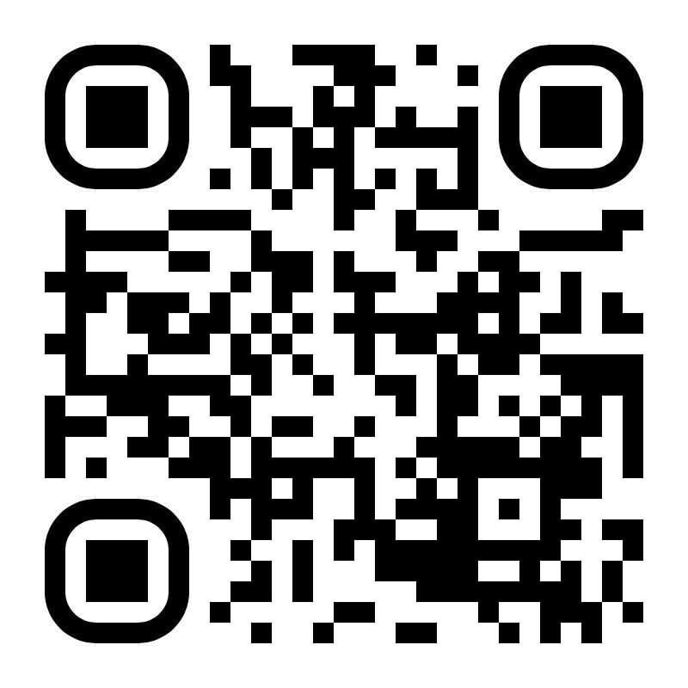
Conclusion
Slidedeck and information available at:
https://ogmini.github.io/talks
Work and thoughts are solely my own and not that of my employer
Notes:
Thank you listening to my presentation. I hope it was informative and you can find a copy of the slide deck at my website
Thanks!

